Slide 1
SESSION 1
Segment 3: Why Databases
Segment 4: Types of Databases
Segment 5: Introduction to RDBMS

Slide 2

WHY DATABASES?

Slide 3
CASE: RESTAURANT LISTING WEBSITE
Examples of such a website: Zomato, Swiggy
Types of data:
User data (Login)
List of cities and localities
Restaurant data (List of restaurants)
Menu at restaurants
Images of food and restaurant
User reviews

Slide 4
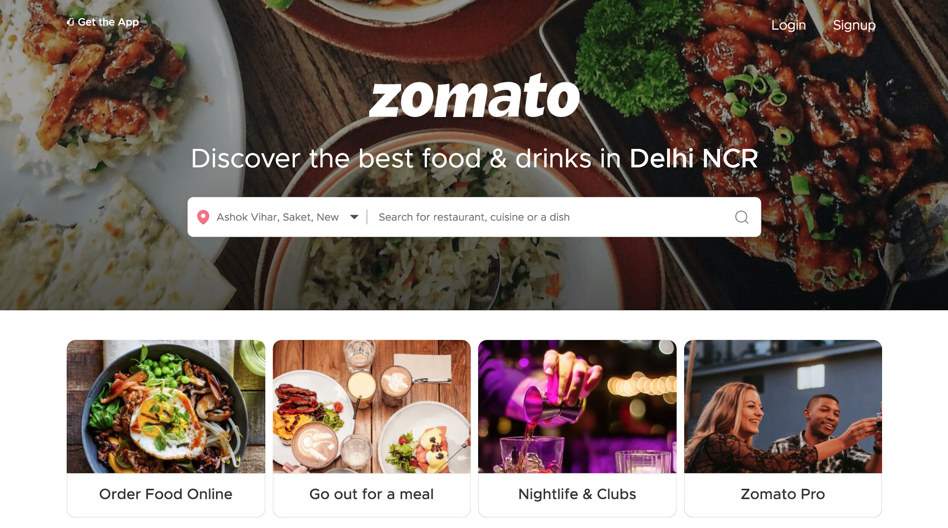
Data:
User login/signup
Location
Cuisines
Dishes
Source: Zomato website

Slide 5
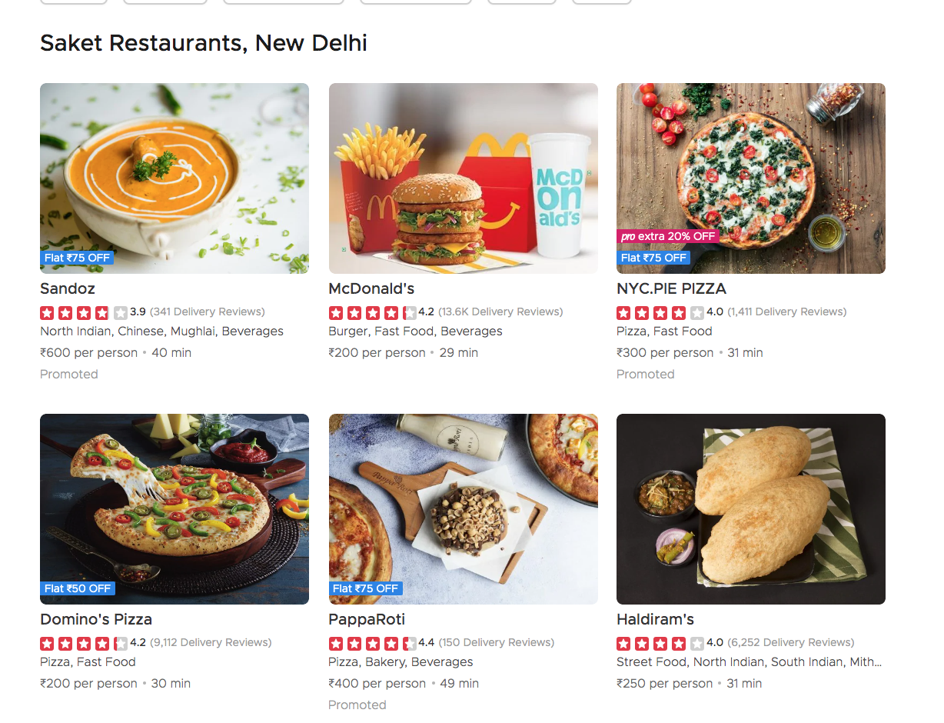
LIST OF RESTAURANTS IN SAKET, NEW DELHI ON ZOMATO
Data
List of restaurants in Saket, New Delhi
Restaurant details
Name
Cuisines
Average rate per person
Rating
Food images
Estimated time of Arrival(ETA)
Source: Zomato website

Slide 6
Database
Storage
Query

Slide 7
QUERY
Create
1
Creating/adding/inserting a new record. Example : Zomato adds a new restaurant on its website
Read
2
Retrieving data.
Example: User can see all the restaurants listed with Zomato.
Update
3
Changing an existing record.
Example: User updates his/her location on Zomato
Delete
4
Deleting an existing record.
Example: Zomato deletes a previously existing restaurant on its website.

Slide 8
Types of Databases

Slide 9
STRUCTURED vs UNSTRUCTURED DATA
Structured data
Unstructured data
Organised data in tables, rows, columns, and relationships
Cannot be organised in rows, columns, tables, and relationships
Dates, Customer details, Employee details, Order details
Images, audio files, video files, JSON files, emails, etc.
About 20% of enterprise data
More than 80% of enterprise data
Less storage required
Requires more storage
Easier to process information
Difficult to manage and process

Slide 10
DATA AND DATABASES
Structured Data
Unstructured Data
Relational Databases
NoSQL Databases
Notes:
Please recheck animation

Slide 11

TYPES OF DATABASES
Relational Databases
NoSQL Databases
Data items have pre-defined relationships between them
Information is stored in structured tables with rows and columns.
Examples: MySQL, IBM DB2, Microsoft SQL Server
Uses a storage model optimised for specific requirements of the type of data being stored.
Document, Key-Value, Columnar, Graph Databases
Examples: MongoDB, Apache Cassandra, Redis, Couchbase and Apache HBase.

Slide 12
Introduction To RDBMS

Slide 13
Data | Database | Database Management System | Relational Data | Relational Database | Relational Database Management System
Information | Storage of information | Software that helps in performing CRUD operations to data in the database. | Data has relationship | Database that stores structured and relational data -Based on Relational Data Model | Software that helps in performing CRUD operations to structured data in relational database.

Slide 14
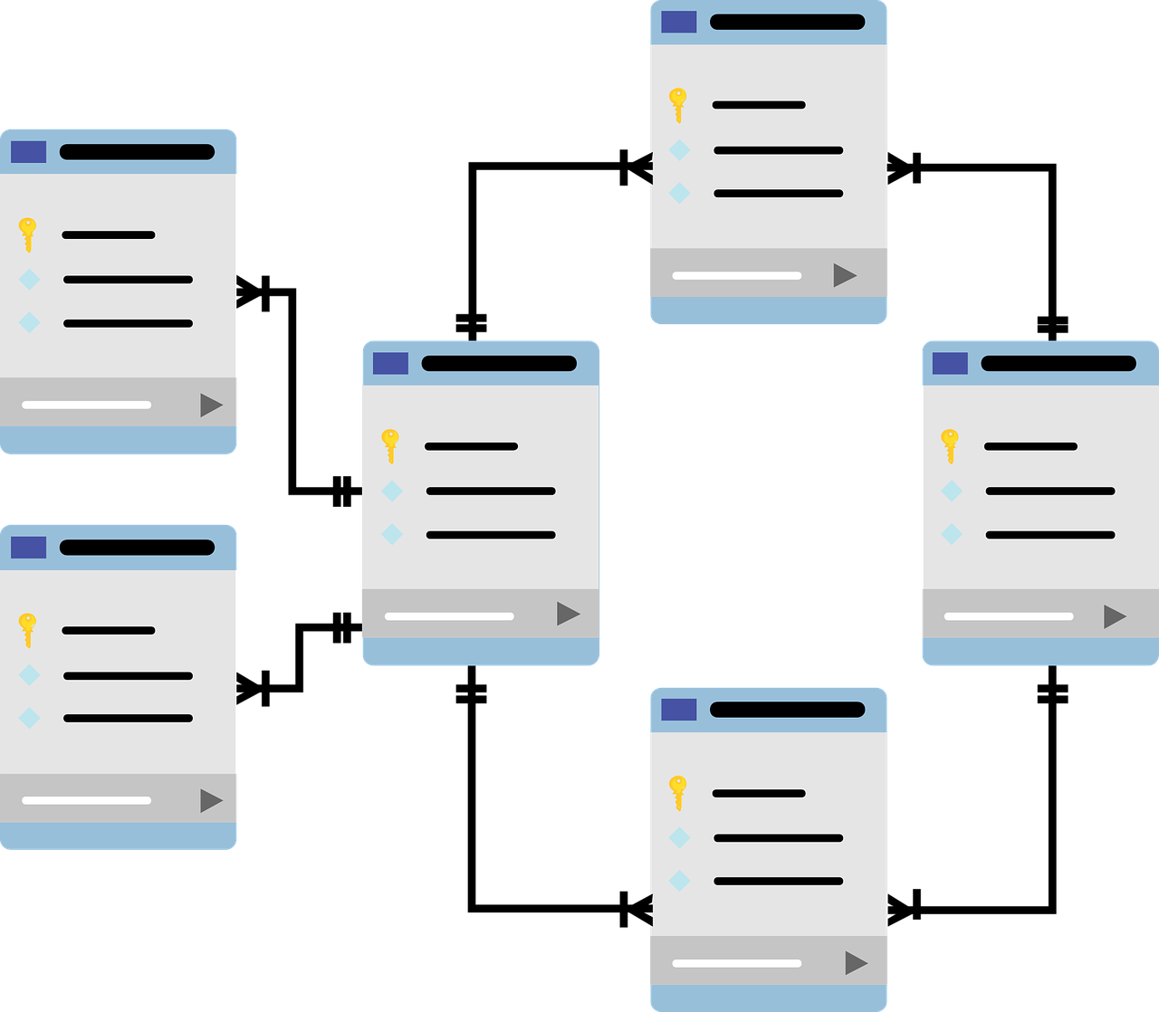
RELATIONAL DATA MODEL
Proposed by EF Codd in 1969
Model data in the form of relations
Based on two concepts:
Tables
Relations
Relationships (1:1, 1;n, N:N)

Slide 15
RELATIONSHIPS IN DATABASES
One-to-One
One-to-Many
Many-to-Many
Citizen of India
Country
Subjects
Aadhar Card
Residents
Students

Slide 16
SCENARIOS FOR RDBMS
Strict schema
Relational data
Transactional requirements
When data can be stored on a single server

Slide 17
INDUSTRIAL USE CASES OF RDBMS
Banking - Money transaction system
Money Wallet - Google Pay, PhonePe
E-commerce - Payments, users, etc.
Restaurant Listing - Zomato
Employee Management Software
Twitter uses MySQL heavily for primary storage of Tweets and Users
YouTube uses MySQL

Slide 18
End of Session 1

Slide 19
SESSION 2
Segment 3: Introduction to MySQL
Segment 4: Types of SQL Commands - DDL, DML, DQL,
Segment 5: SQL Basic Statements and Operators
Segment 6: Aggregate and InBuilt functions
Segment 7: String and Date-Time Functions
Segment 9: Joins

Slide 20

INTRODUCTION TO MYSQL
A 25-year-old language
Free and open-source
Relational Database Management System
Interact directly with a MySQL database using SQL
Wikipedia, Twitter, Flipkart - few of many who use MySQL
Structured Query Language (SQL)

Slide 21
TYPES OF SQL COMMANDS
Data Definition Language -DDL
CREATE – Used to create the database or its objects (e.g. table, index, function, views, store procedure and triggers).
DROP – Used to delete objects from the database.
ALTER- Used to alter the structure of the database.
TRUNCATE– Used to remove all records from a table, including all spaces allocated for the records.
RENAME – Used to rename an object existing in the database.
Data Manipulation Language - DML
INSERT – Used to insert data into a table.
UPDATE – Used to update existing data within a table.
DELETE – Used to delete records from a database table.
Data Query Language - DQL
SELECT – Used to retrieve data from a database.

Slide 22
SQL BASIC STATEMENTS AND OPERATORS
SELECT: Used to read the data
WHERE: Used as a conditional statement to filter out data
Some examples of operators that can be used along with the WHERE clause are OR, AND, IN, BETWEEN, and LIKE

Slide 23
AGGREGATE AND INBUILT FUNCTIONS
COUNT(): Counts the total number of records specified by the given condition
SUM(): Returns the sum of all the non-NULL values
AVG(): Returns the average of all the non-NULL values
MIN(): Returns the minimum of the specified values (NULL is not included)
MAX(): Returns the maximum of the specified values (NULL is not included)

Slide 24
STRING FUNCTIONS
FUNCTION | EXAMPLE | DESCRIPTION | OUTPUT
UPPER | SELECT UPPER(‘upgrad’); | Converts to uppercase | UPGRAD
LOWER | SELECT LOWER(‘UPGRAD’) | Converts to Lowercase | upGrad
SUBSTRING | SELECT SUBSTRING(‘upgradeability’,1,6) | SUBSTRING(text,start_index,length of substring) | upgrad
SUBSTRING_INDEX | SELECT SUBSTRING(‘www.upgrad.com’,’.’,1) | Returns the substring before the mentioned delimiter | www
 | SUBSTRING_INDEX(‘www.upgrad.com’,’.’,2) | SUBSTRING_INDEX(text,delimiter,occurrence number of delimiter) | www.upgrad
LENGTH | SELECT LENGTH(‘upgrad’) | Gives the number of characters in the input | 6
REVERSE | SELECT REVERSE(‘upgrad’) | Reverse the String | dargpu

Slide 25
DATE-TIME FUNCTIONS
SYNTAX | DESCRIPTION | OUTPUT
SELECT CURTIME() | Returns the current time | 17:11:12
SELECT MONTH(‘2020-03-10’) | Returns the month of the date | 03
SELECT MONTHNAME(‘2020-03-10’) | Returns the name of the month of the given date | March
SELECT STR_TO_DATE(‘10,03,2020’,’%d,%m,%y’) | Converts the String to date type | 2020-03-10
SELECT YEAR(‘2020-03-10’) | Extract the year from the date | 2020
SELECT DAYNAME(‘2020-03-10’) | Return the day of the week for the given date | Tuesday
SELECT DAYOFMONTH(‘2020-03’10’) | Extract the day of the month from the given date | 10

Slide 26
JOINS
This is a method of linking data between one or more tables based on values of the common column between the tables.
It can be used to combine rows from two or more tables
It is used with the SELECT statement

Slide 27
VENN DIAGRAMS
(Refresher)
Union A U B
Intersection A n B
Minus A - B
Minus B - A
A
B
A
B
A
B
A
B

Slide 28
JOINS
Inner join
Full join
Left join
Right join
Left table
Right table
Left table
Right table
Left table
Right table
Left table
Right table

Slide 29
End of Session 2

